Slide 1

BIG MOUNTAIN RESORT
Optimizing Pricing

Slide 2
WHAT TO ADDRESS?
Pricing Strategy
WHY?
To make the most out of the facility offerings of the resort
To allow for the resort to earn more money going forward
HOW?
Cost cutting OR raising ticket price
DATA AT HAND
.csv file provided from database manager
State data extracted from Wikipedia

Slide 3
WHAT IS THE SOLUTION?
Alongside the extra chair lift recently installed by the resort, the following additions would further bolster increasing the ticket price of the resort by $2:
Adding another run
Increasing vertical drop by 150 feet
Implementing the above, could result in the resort earning a revenue at the end of the season of $3,474,638.

Slide 4
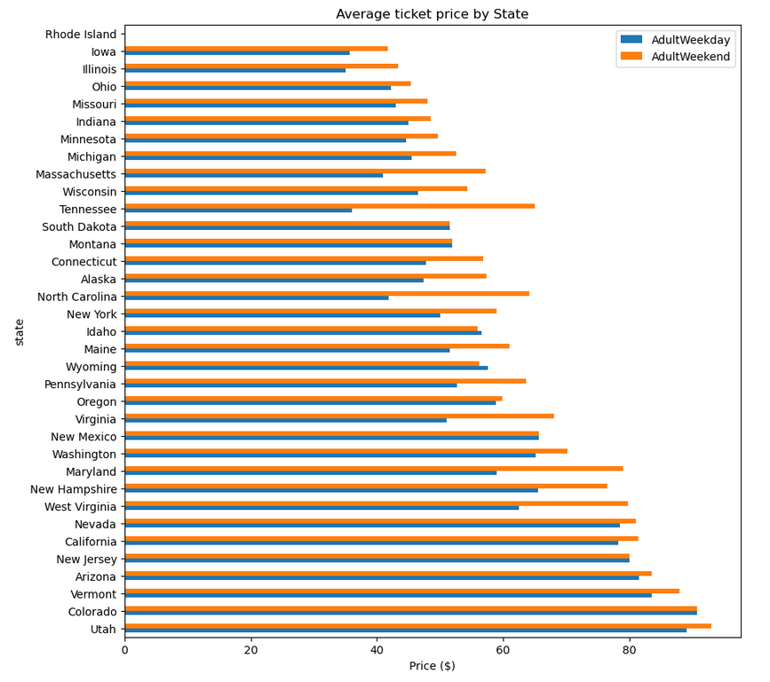
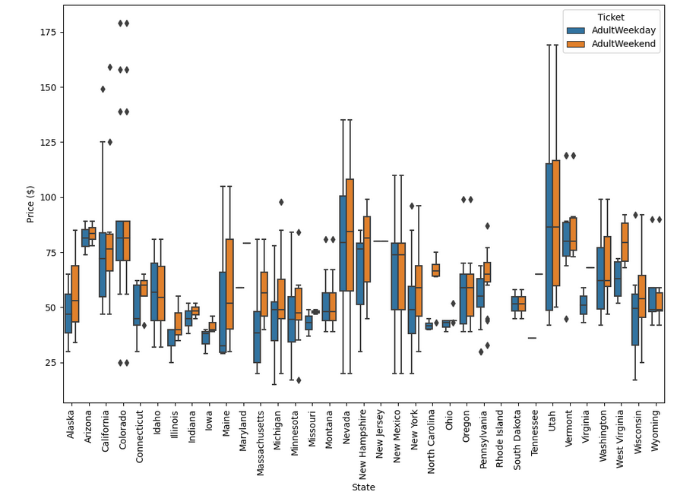
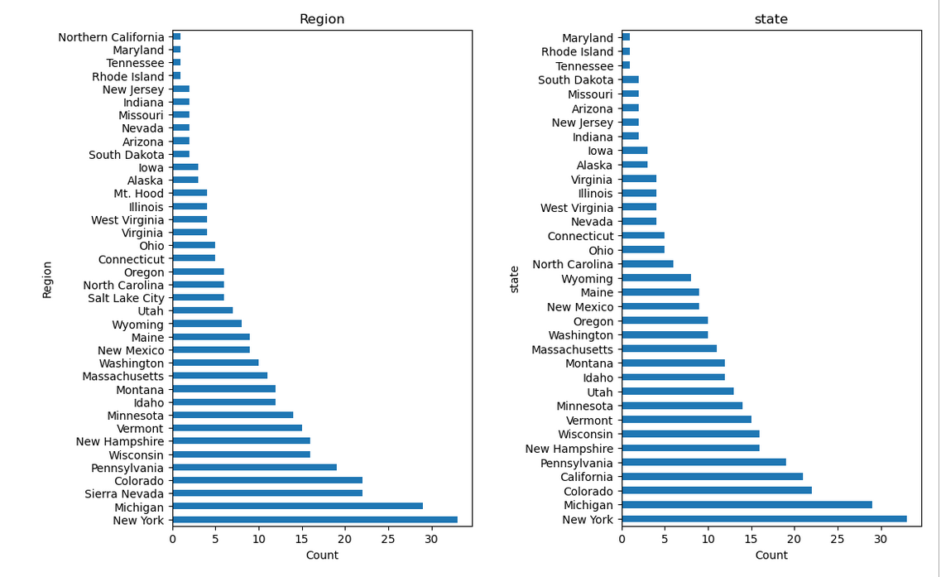
DATA OBSERVATIONS
Though there were 2 pricing metrics, “AdultWeekend” was used for the study representing ticket prices for resorts.
Montana fell along the middle of the distribution of resorts by state, and resort prices by state.
Montana, moreover, had less variance overall in average price distribution.

Slide 5
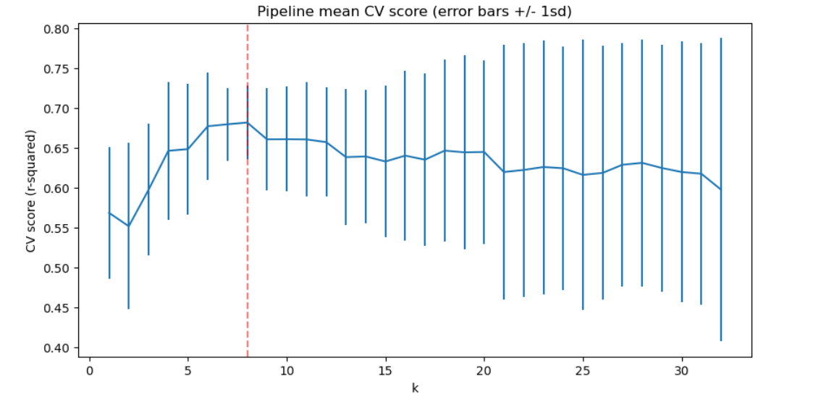
MODEL SHOWED IDEAL NUMBER OF FEATURES TO EXPERIMENT WITH IS 8

Slide 6
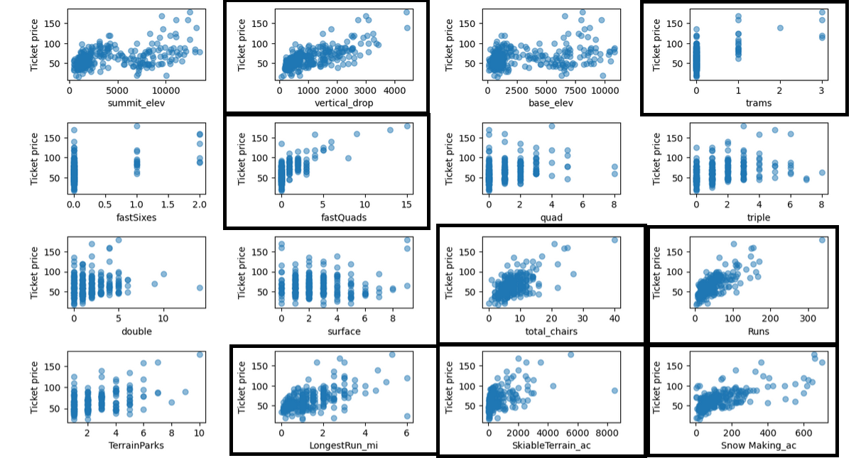

RESORT FEATURES CLOSELY TIED TO PRICE

Slide 7
WHAT DID THE MODEL TRY?
Closing up to 10 of least used runs
FINDING- Closing more runs leads to a decrease in the ticket price
Adding a run, increasing vertical drop by 150 ft, and installing a chair lift
FINDING- Price increases by $2; expected revenue is $3,474,638.
Adding a run, increasing vertical drop by 150 ft, installing a chair lift, and adding 2 acres of snow making
FINDING- Price increases by $2; expected revenue is $3,474,638.
Increasing longest run by 0.2 miles, and adding 4 acres of snow making
FINDING- No change

Slide 8
IN CONCLUSION
Although the model tried 4 different variations of the top features associated with ticket price, the best solution that came out was adding the following features along with the extra chair lift:
Adding another run
Increasing vertical drop by 150 feet
Implementing the above, allows the resort to increase ticket price by $2 and could result in the resort earning a revenue at the end of the season of $3,474,638.

